Slide 1




FELIX MUKUNGU
Founder, The Core
Bitcoin Educator
Printing Services
MukunguFelix
Felix Divoar
felixdivoar

Slide 2
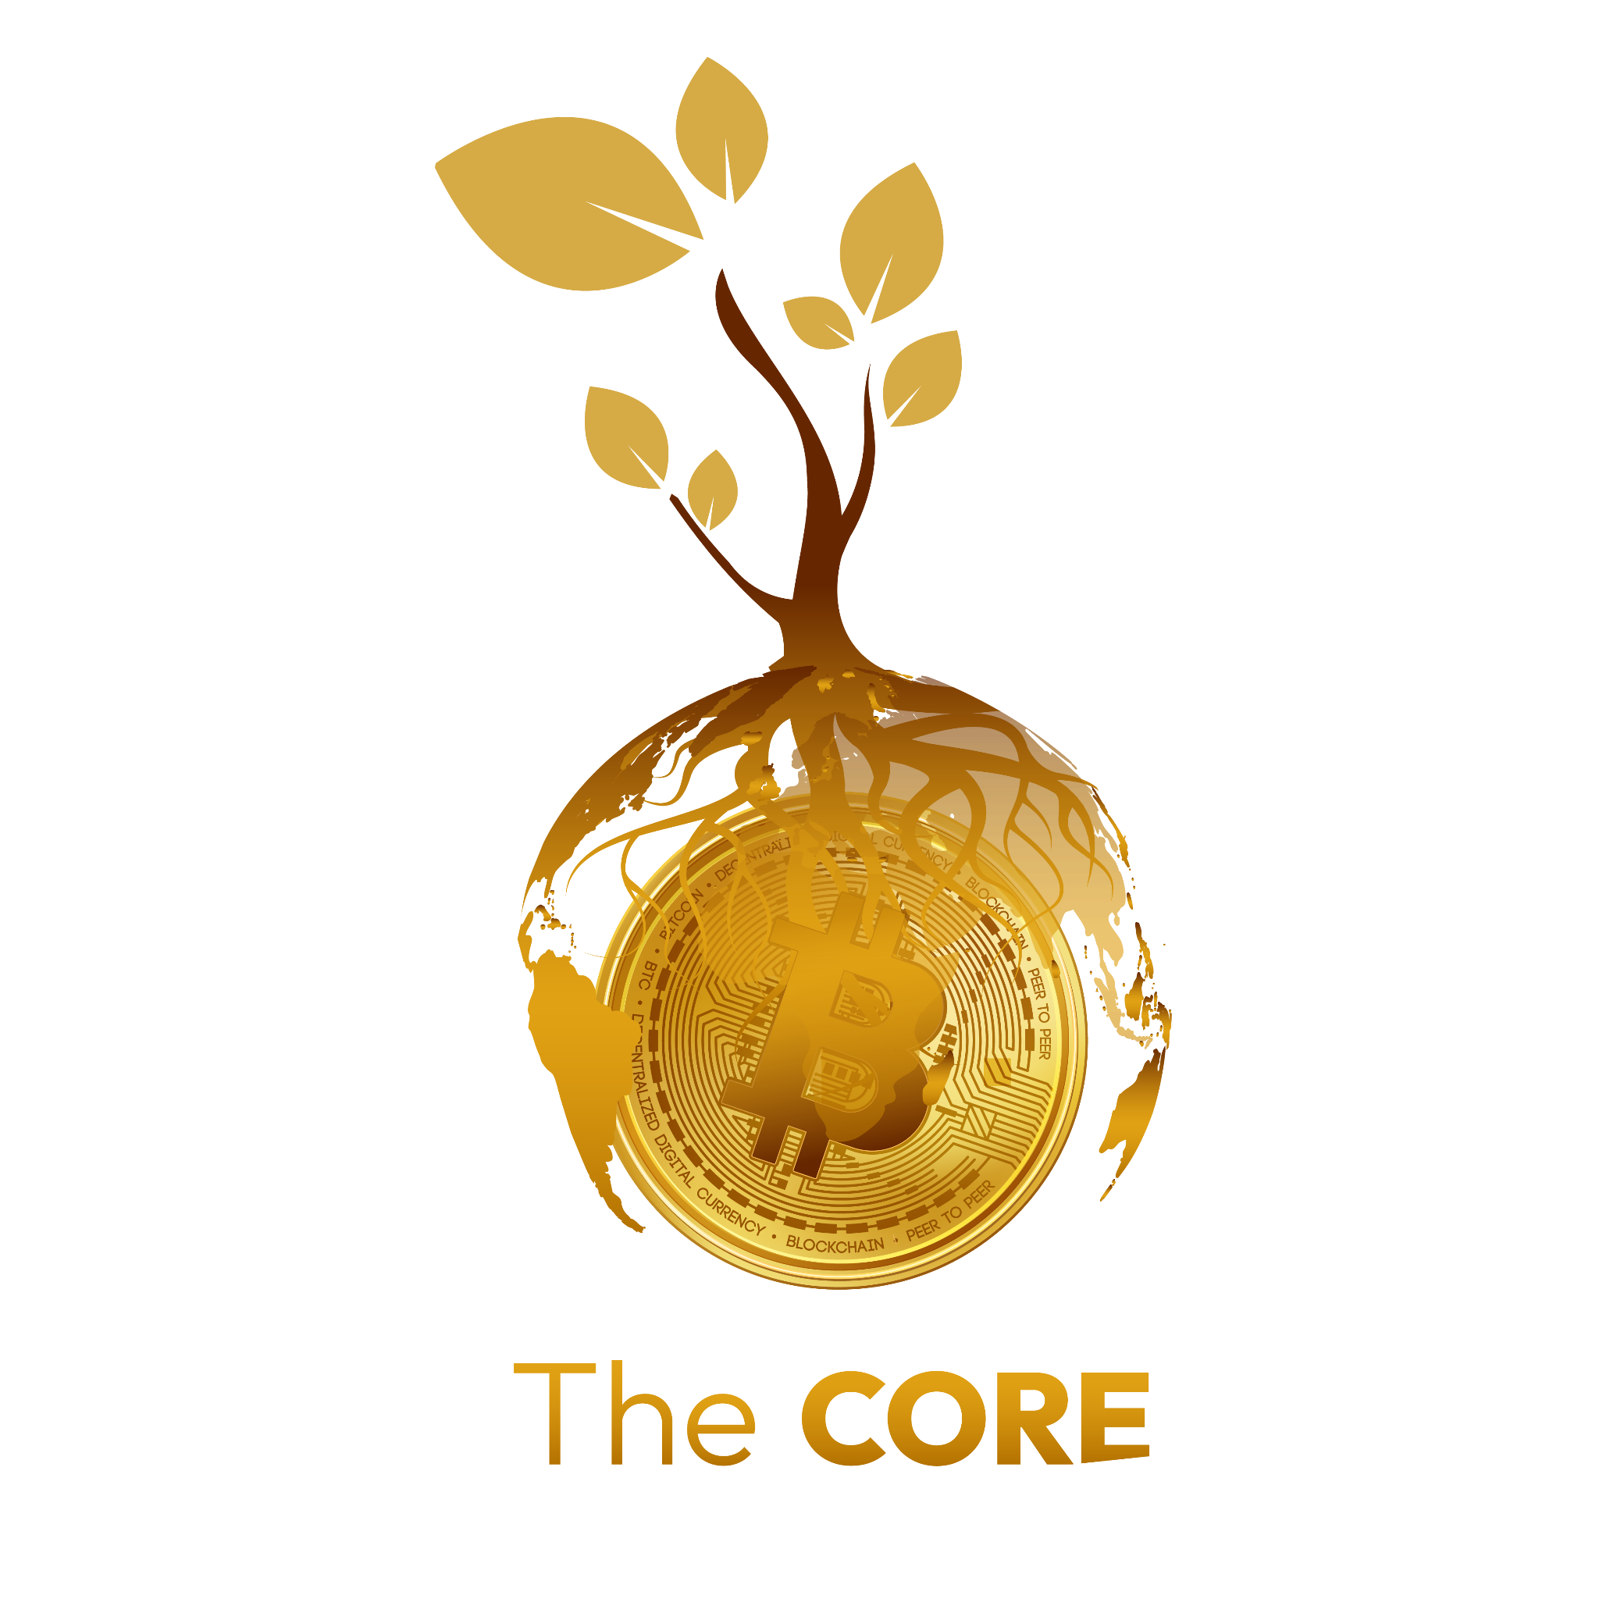
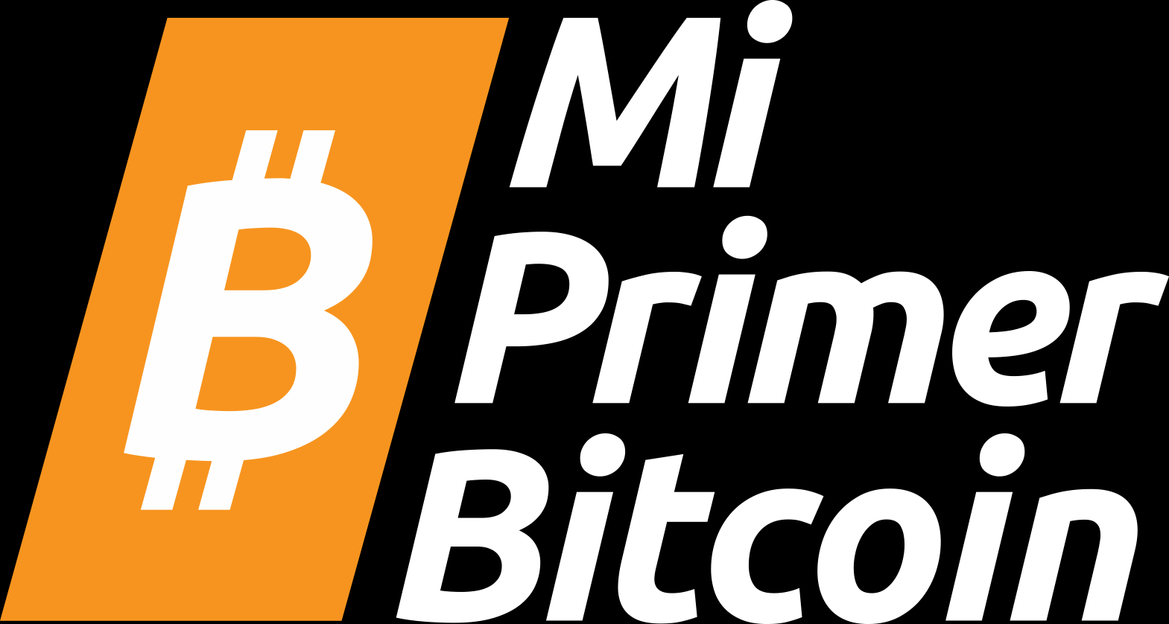
CHAPTER 6
AN INTRODUCTION TO
BITCOIN

Slide 3
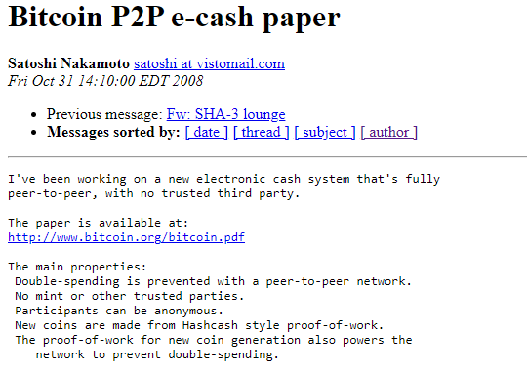

Slide 4
A visionary mind by the name “Satoshi Nakamoto.” This anonymous person (man, woman, or group), long before Bitcoin, was part of cryptography enthusiasts like computer scientists and hackers, engaging in discussions to find practical solutions to replace the fiat system.
In October 2008, Nakamoto unveiled a groundbreaking whitepaper titled, “Bitcoin: A Peer-to-Peer Electronic Cash System” on a cryptography mailing list. This document laid the foundation for a decentralized peer-to-peer protocol, designed to facilitate secure online transactions without the need for intermediaries. Nakamoto's vision was clear: to create a purely peer-to-peer version of electronic cash, free from the control of
powerful governments and financial institutions.

Slide 5
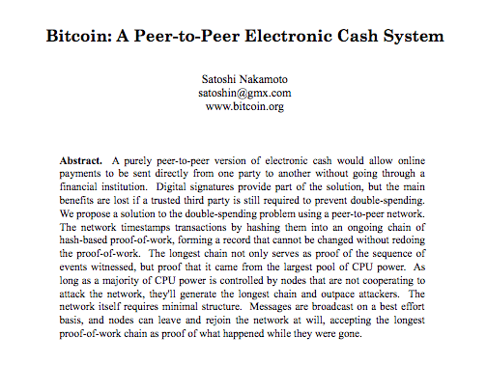

Slide 6
Genesis Block
The Bitcoin Genesis Block, also known as Block 0 , is the very first block mined on the Bitcoin blockchain. It was created by Bitcoin's pseudonymous inventor, Satoshi Nakamoto, on January 3, 2009. This block marks the beginning of the Bitcoin blockchain and serves as the foundation for all subsequent blocks.
In 2011, after the Bitcoin network proved it could operate successfully without the need of its influential creator, Nakamoto sent an email to a fellow Bitcoin developer, announcing to remove themselves from the Bitcoin scene and giving its future away to other “good hands” that shared their vision.

Slide 7
Although Nakamoto’s identity remains a mystery until this very day, their goal for creating Bitcoin was never a mystery. In essence, Nakamoto created it to take the power away from the few and give it back to the many by creating an alternative in the form of a decentralized, open-sourced, Transparent money system, separating money from the state. Creating Bitcoin was Nakamoto’s response to the 2008 financial crisis that hurt regular people worldwide while enriching the elite
class—again. Bitcoin was Nakamoto’s answer on the corruption and fragility of the fiat system. Nakamoto set the foundation for a new revolution and walked away from it instead of claiming credit.

Slide 8
How Does Bitcoin Work?

Slide 9
So, how does Bitcoin work? Bitcoin has lots of features, and the rabbit hole goes deep—very deep.Fortunately, if you enter the Bitcoin world for the first time, you do not have to perfectly understand how it works to start using it. The same counts for using the internet. Most people do not know how the TCP/IP protocol works, yet they send emails, messages, and post content on their social media accounts every day. The same goes for driving a car—most people do not know exactly how a car works, yet they do know how to drive.

Slide 10
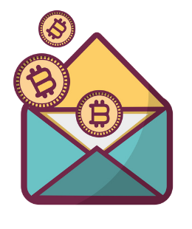
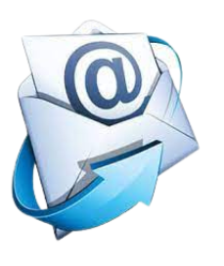

Slide 11
The key idea behind how Bitcoin operates can be condensed into one sentence: Bitcoin is an agreement among people online. You can think about it like playing a board game with friends. With a game like Monopoly, you are in agreement with the other players about specific rules. One of the rules of Monopoly is that only special “Monopoly bills” are to be accepted. If James, (one of the players), goes against the rules by using toilet paper to buy a house instead of Monopoly bills, the other players would tell James he is a cheater and would simply stop playing with him. In short, to play the game, you have consensus on a set of rules with each other and you do not drift away from those rules, otherwise you will be rejected.

Slide 12
This is essentially how Bitcoin works. Bitcoin is a network of people that agrees on the same set of rules. These rules are mathematically bound, written in computer code, and accepted directly by everyone who runs the Bitcoin software. The rules of Bitcoin apply to all participants equally, which means that everyone either follows the rules of the game or they are unable to play because the network will reject them.
For example, one of the rules of Bitcoin is, "There will never be more than 21 million bitcoins." If someone wanted to create a million extra bitcoins for themselves, it will be of no use to them because they would automatically be identified and rejected by everyone else. This is what makes Bitcoin so robust.

Slide 13
Part 2

Slide 14
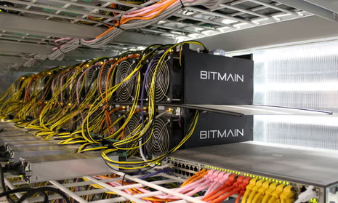
The Players of the Game
Miners are the backbone of Bitcoin. These are people or groups of people who work behind the scenes to maintain and secure the network through a mechanism called Proof-of-Work (PoW). These players are armed with special computers that contain heavy computational power.

Slide 15
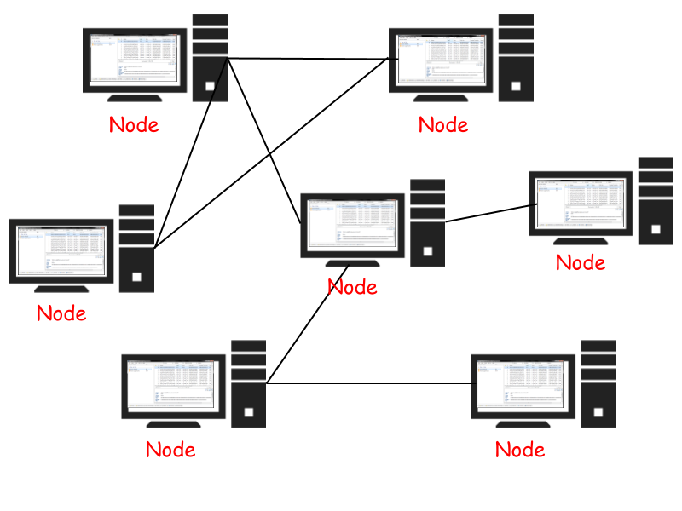
The Players of the Game
2. Nodes: Gatekeepers of Validation
Bitcoin nodes are ordinary people who live across the planet. These participants form the gatekeepers of the Bitcoin network by running the Bitcoin software on their small computers in which they maintain a copy of the entire ledger. Nodes validate transactions and ensure that all participants adhere to the consensus rules. By distributing the responsibility of validation across a network of nodes, Bitcoin remains resilient against attacks
and maintains its trustless nature.

Slide 16
The Players of the Game
Users: Empowered Participants
Users—the lifeblood of the Bitcoin network—are individuals who engage in transactions. You can think about users as regular people who just live their lives but who also empowered themselves by integrating Bitcoin. For example, some users save their money in bitcoin while others, like citizens of El Salvador, use it as money to buy groceries and receive bitcoin in the form of a salary.

Slide 17
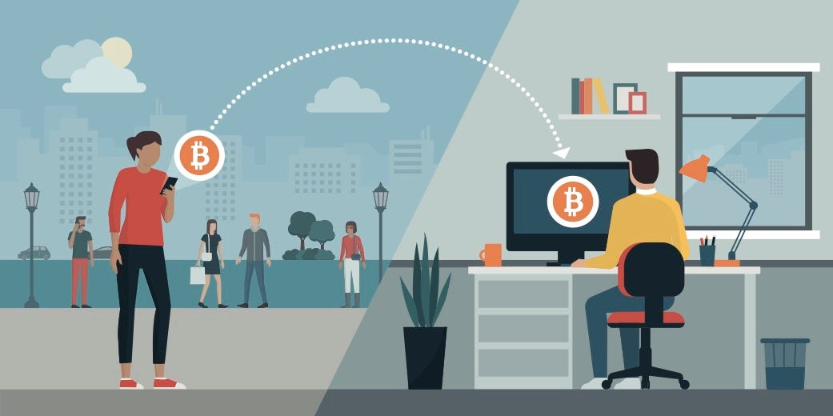
The Players of the Game

Slide 18
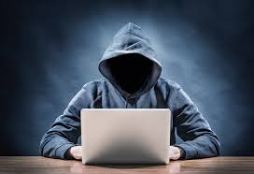
The Players of the Game
Developers and Projects:
Developers wield their technical expertise to enhance and innovate the Bitcoin protocol. These individuals contribute code, propose improvements, and address vulnerabilities, ensuring the network evolves in response to all types of challenges. Bitcoin's open-source nature invites collaboration, allowing developers worldwide to contribute to its growth.

Slide 19
The Players of the Game
The Symphony
Bitcoin's decentralization can be thought of as a synergetic musical orchestra, a balancing act where all the different musicians make the most beautiful music together. There is no boss in the Bitcoin network; instead, miners, nodes, users, developers, and projects perform their roles with autonomy and collaboration.
The decentralized ledger, maintained by nodes, guarantees transparency, while the proof-of-work mechanism provides security and deters centralization in mining. Users experience financial sovereignty and empowerment, free from the control of the fiat system. Developers, guided by consensus, ensure the protocol adapts to meet the evolving needs of humanity. Bitcoin projects, in their own unique ways, contribute to the broader mission of collective freedom.

Slide 20
Bitcoin as Sound Digital Money
In simple terms, Bitcoin is money. Bitcoin is not an investment but rather a safe, empowering way of saving your hard-earned money. Having bitcoins won’t make you rich because it won’t give you a return of more bitcoins. Its value, measured against a fiat currency, does go up, but this is only because of its growing adoption and the devaluation of fiat currencies.
In simple terms, Bitcoin is money. Bitcoin is not an investment but rather a safe, empowering way of saving your hard-earned money. Having bitcoins won’t make you rich because it won’t give you a return of more bitcoins. Its value measured against a fiat currency, does go up, but this is only because of its growing adoption and the devaluation of fiat currencies.

Slide 21
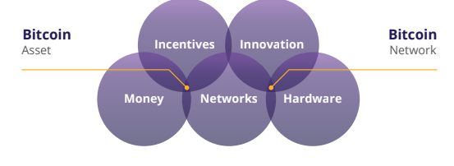
Bitcoin as Sound Digital Money

Slide 22
Bitcoin as Sound Digital Money
Bitcoin is a new form of money; it is, “The Internet of Money," which means that it is open for anyone to join and start exchanging value with other users. Even the most isolated and poor communities in the world finally have access to a monetary system. Just like everyone who has a phone and an internet connection can use a search engine, Bitcoin makes it possible for everyone with a phone and internet connection to access a new, global monetary system.

Slide 23
Bitcoin as Sound Digital Money
6.2.2 Bitcoin’s Features
The first stage of money, a store of value, is when a currency starts gaining trust as a stable (or appreciating) asset over time. People who recognize this early seek to protect their wealth by storing it in this form of money, especially during a time of geopolitical and macroeconomic uncertainties.
Some groups, like media outlets, call Bitcoin a form of “digital gold.” This is because Bitcoin firmly established itself as a store of value during the past decade. Every day, more and more people start viewing Bitcoin as a hedge against inflation, like gold did historically.

Slide 24
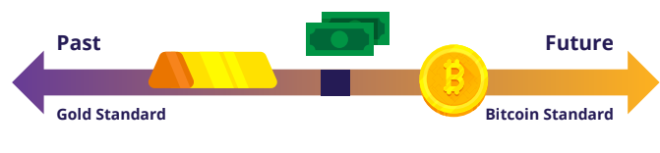
Bitcoin as Sound Digital Money
The next stage is when confidence in the stability of a currency solidifies. This is when the currency transitions into a medium of exchange, facilitating transactions in people’s daily lives. During this stage, currency starts to become widely accepted for the exchange of goods and services.

Slide 25
Bitcoin as Sound Digital Money
In the final stage, a currency achieves the status of a unit of account, serving as a common measure for pricing goods and services. This is the stage in which it becomes the standard metric against which all other values are measured.
Properties of money
Durability: Bitcoin is purely digital and thus completely durable.

Slide 26
Properties of money
Divisibility: For comparison, the fiat currency USD can be divided to the cent (.01). Bitcoin can be divided into what is known as a satoshi or sat (.00000001). And because of Bitcoin’s digital character, it can be even more divided in the future if humanity needs it. Bitcoin is currently the most divisible monetary asset in the world.Bitcoin is purely digital and thus completely durable.
Acceptability: Bitcoin is still in its early stages of becoming a medium of exchange, and compared to fiat currencies, acceptability is currently low.

Slide 27
Properties of money
Scarcity: There will only ever be 21 bitcoins million in existence. By code, it is impossible for this amount to ever increase, which means that Bitcoin is not only scarce but is also the scarcest monetary asset in the world.
Portability: In April 2020, $1.1 billion was transferred in just a few minutes, and it only cost 68 cents. No other way of paying can move that much money at that low cost so quickly, and all on its own. This is what makes Bitcoin the most easily movable form of money in the world.

Slide 28
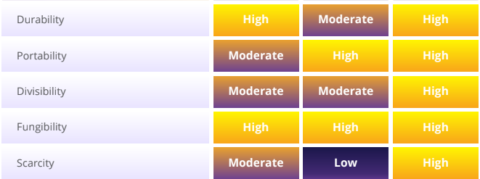
Properties of money
Fungibility: Each unit of bitcoin is the same as any other unit and can be interchanged and transacted over the Bitcoin protocol on a like-kind basis, which makes it a fungible currency.

Slide 29
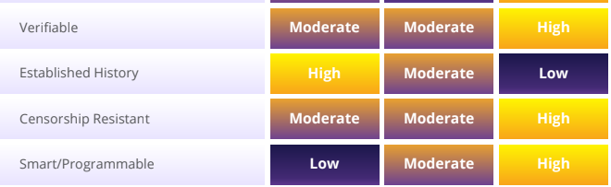
Properties of money

Slide 30
“The result is a distributed system with no single point of failure. Users hold the crypto keys to their own money and transact directly with each other, with the help of the P2P network to check for double-spending”.
Satoshi Nakamoto
In the fiat world, people rely on governments, banks, and established payment providers. The heads of these (financial) institutions set the rules of the network, and the participants, mostly ordinary citizens, must comply with these rules. It doesn’t matter where you live—there are always a set of standard procedures that instruct you on what to do and how to do it. Over time, this led to a cycle of hardship, particularly for families that struggle with the increasing challenges of daily life.

Slide 31
As you know, the monetary system of Bitcoin is very different. Bitcoin operates in a specific way, and rulers have been replaced by an autonomous system of rules. There is no dictator or leader, which also means that no one will dictate to you what you need to do. If you want the newfound freedom and empowerment of Bitcoin, you will need to learn how it works and integrate the
technology in a way that works personally for you.

